Slide 1
Virtual Tastings guide
Commanderie de Bordeaux aux États-Unis

Slide 2
Why host a Virtual Tasting?
COVID-19 does not have to constrain our Bordeaux education and camaraderie.
The components of an effective Bordeaux tasting are:
People
Bordeaux Wine
A challenge (name the year, name the Commune…)
A forum to gather (ZOOM for now)
The objectives are:
To hone our tasting skills
To taste some fine Bordeaux
To build friendships

Slide 3
Best practices
Sourcing wines:
Apportioning wines from the same set of bottles will minimize bottle variation, so that everyone is tasting the same wine.
Alternatively, wines can be purchased and picked up at one local store, with the store having the wines ready for pick-up prior to the tasting.
Tastings need a theme.
Creating a challenge keeps it interesting. Give participants a puzzle to solve. Blind tastings work well for this format.
For educational tastings, discuss the wines before eating any food (unless it’s a food & wine pairing theme).

Slide 4
Example: the Halifax puzzle virtual tasting
Halifax chapter (20 attendees)
Blind tasting - 4 Pauillac, 1 Margaux
Three bottles of each for 20 participants (3 oz pours per participant)
Same vintage
Host decanted wines and divided them into 6 oz. containers, and identified by number
Participant pick-up times were staggered to avoid a crowd
Decanting began about 2 hours prior to first scheduled pick-up, to allow sufficient time
Participants were told the challenge in the initial invitation and Zoom invitation:
Identify the wine from a different commune than the others
All participants began tasting the wines at 3pm.
At 5 pm, the entire group of 20 met by Zoom.
Each group had five minutes to give their conclusions on which wine was different and discuss why (their impression of likely vintage, left vs right bank, how the tannins factored into identifying primary grape varieties).
David King (host) concluded the tasting by revealing the wines with a short explanation as to the clues.
Zoom Meeting Duration – 60 minutes

Slide 5
Suggested themes / challenges for Blind tastings
Name That Vintage
Halifax puzzle (Which wine is different?)
Identify That Commune
Identify Left Bank vs. Right Bank
Rank Wines By Percentage of Cabernet Sauvignon
…Any challenge that asks participants to compare and contrast the wines

Slide 6
Improving tasting skills
See “Discussion Points for the Reveal” at the end of this PowerPoint
Consistency in tasting is key (Appearance, Nose, Palate)
Identifying grape varieties in a blind tasting:
Focus on Structure
Aromas and flavors help to confirm your initial conclusion based on structural elements
Vintage:
May be identified by structural, flavor and aroma characteristics
May help identify grape variety percentages, bank, or commune
See Beyond Flavour: The Indispensable Handbook to Blind Wine Tasting, Nick Jackson, MW (notes from which are included in the Discussion Points for the Reveal at the end of this PowerPoint)

Slide 7
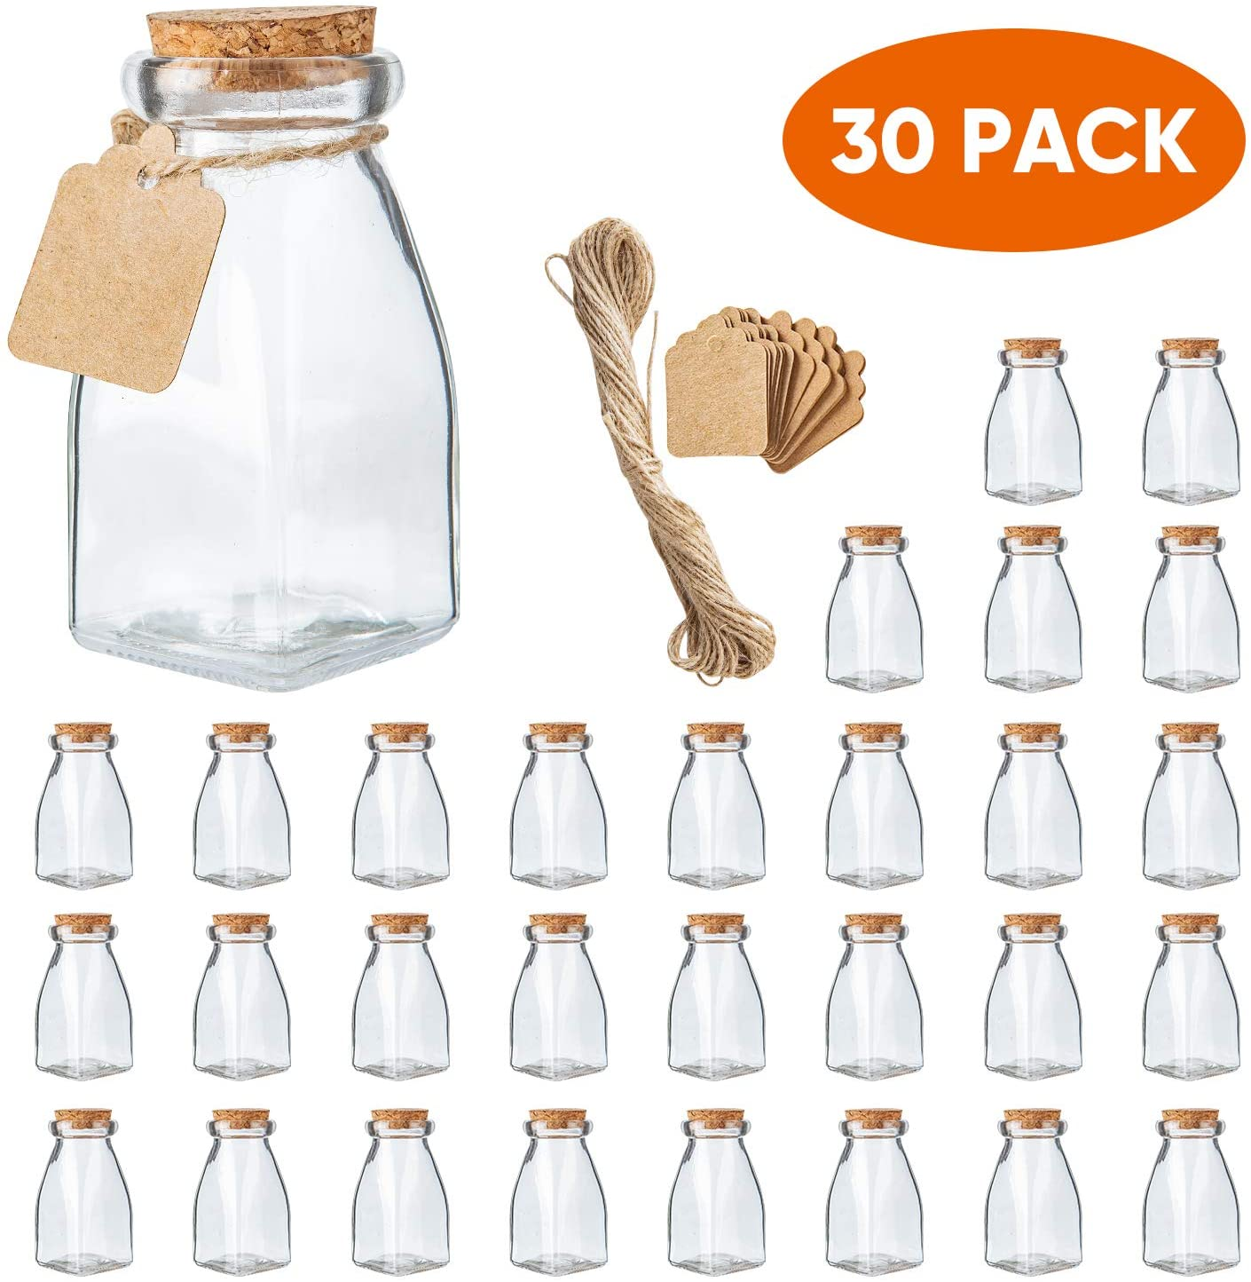
Supplies – container options
4 oz Jar with cork lid (7 oz also available)
Click Here for purchase link
Reusable – have guests return them for future tastings
Easy fill with regular funnel
Wide-mouth easy clean
Clear for easy viewing during filling
$ .83 / bottle

Slide 8
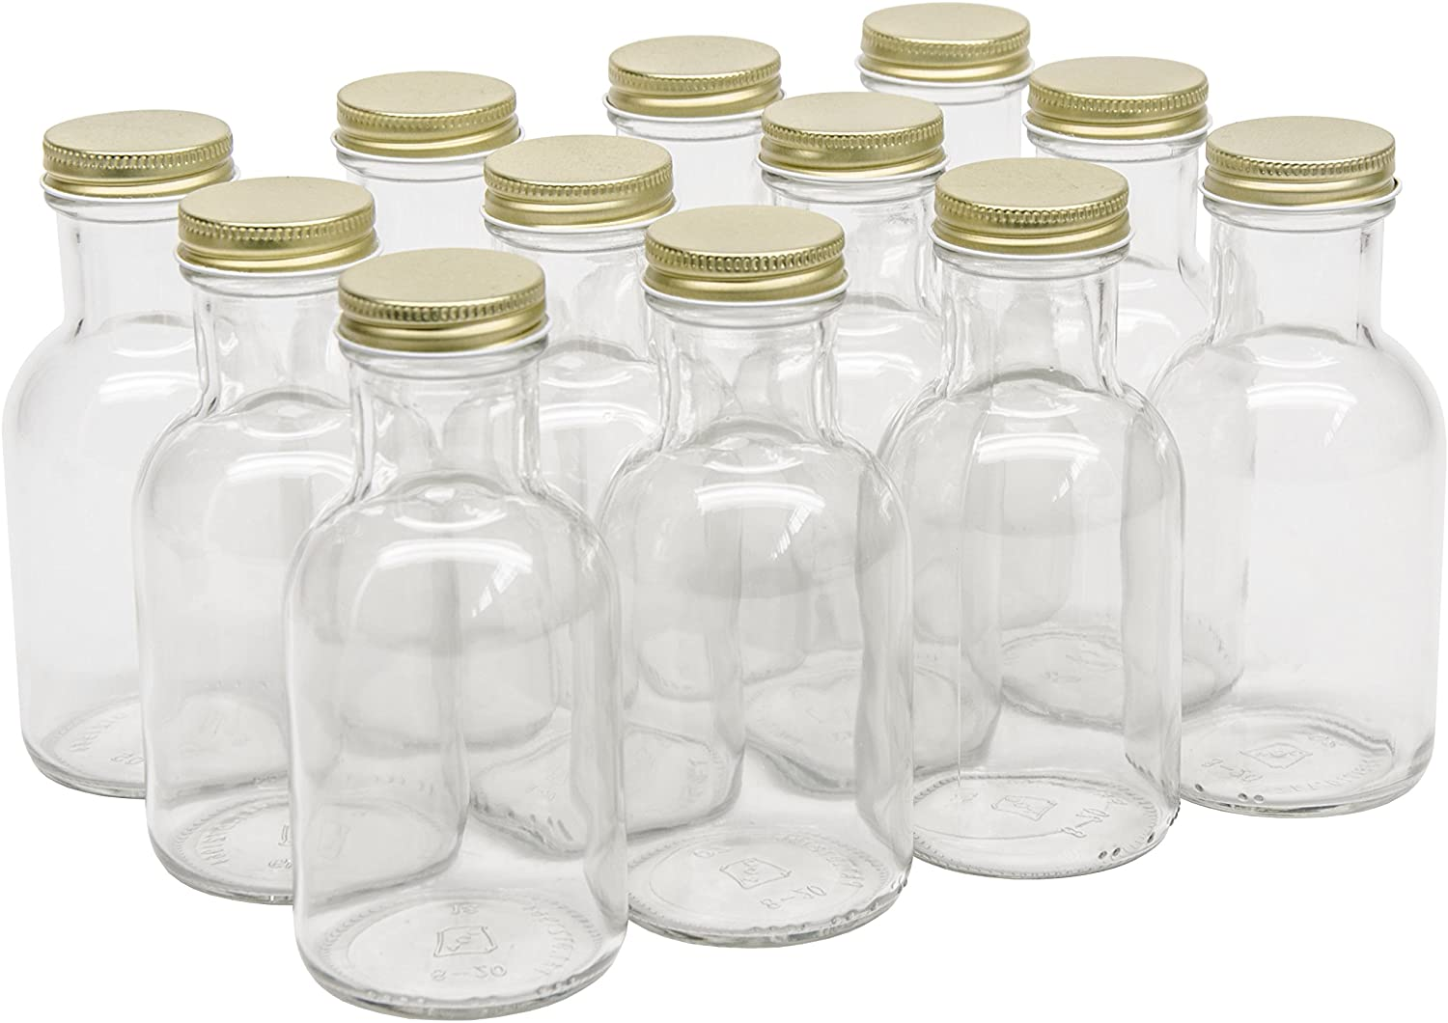
Supplies – container options
8 oz. Sauce bottle with metal lid
Click Here for purchase link
Reusable – have guests return them for future tastings
Easy fill with regular funnel
Wide-mouth easy clean
Clear for easy viewing during filling
$1.50 / bottle

Slide 9
Supplies – container options
4 oz amber bottles with lids
Click Here for purchase link
.53 per bottle (128 count = $68 pre-shipping)
Pros – no head space
Cons – 4 oz opening is 9/16 of an inch
Clear glass available (160 count = $109 pre-shipping)

Slide 10
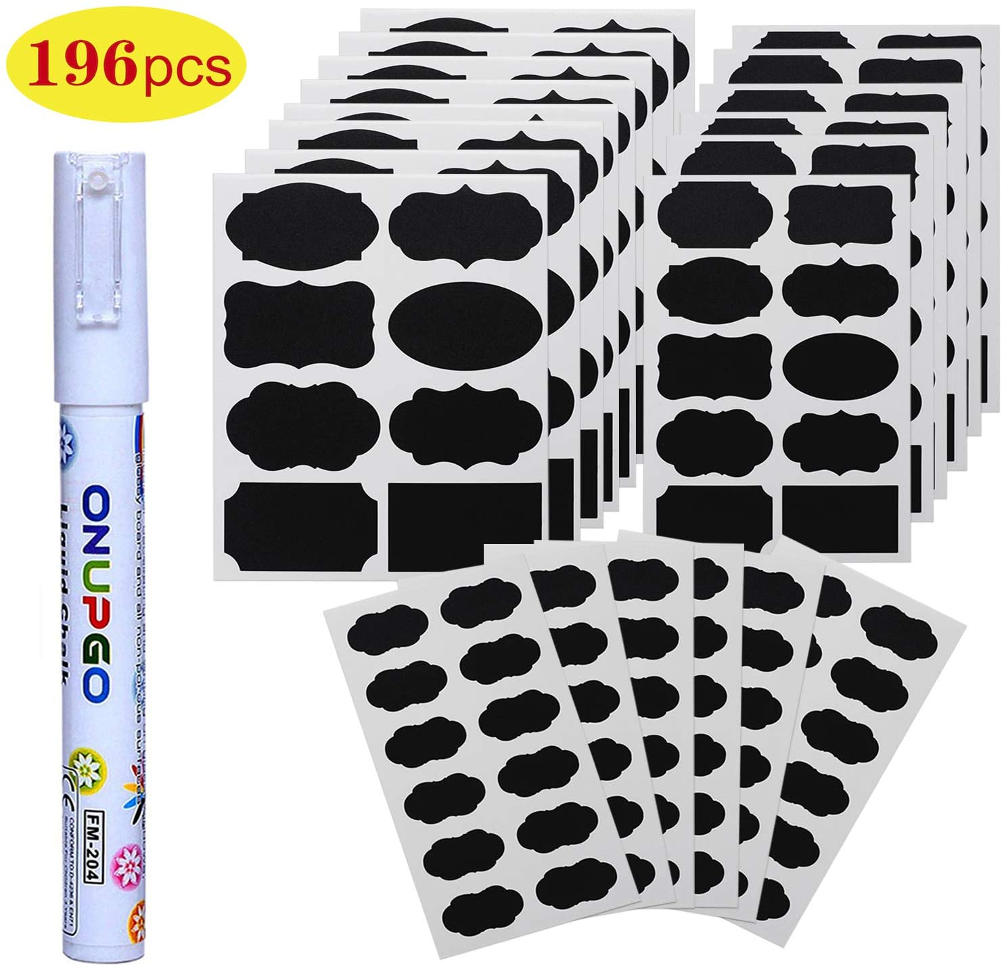
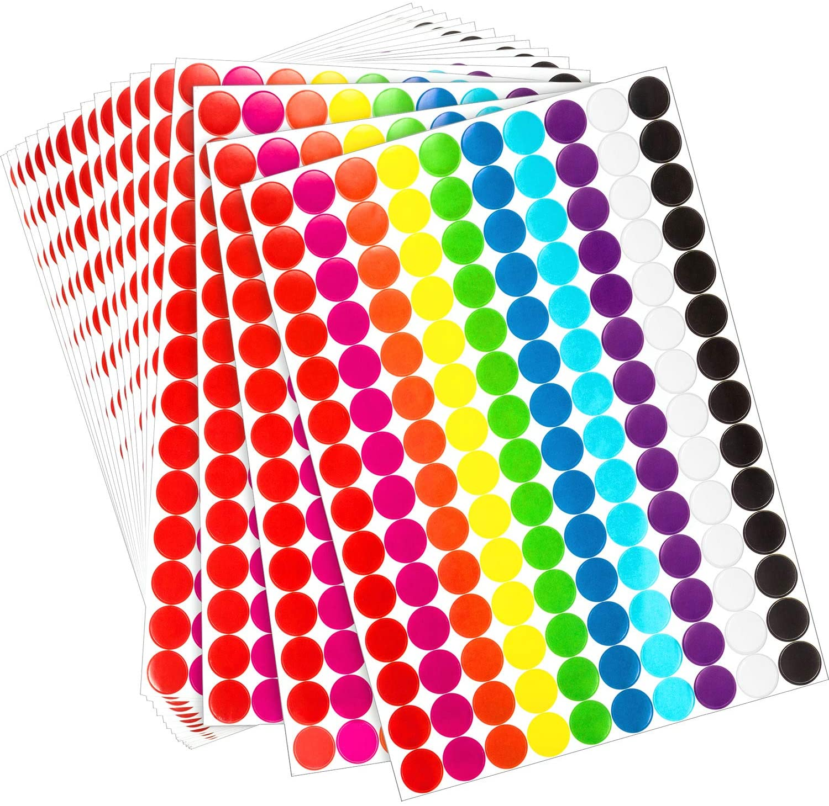
Supplies – labeling
Erasable Chalkboard labels for numbering
Click Here for purchase link
Adhesive labels stay in place even in dishwasher
Click Here for add’l chalk pen
$9 for 196 labels and chalk pen
Color-coded removable adhesive labels
Click Here for purchase link
$9 for 1260 labels

Slide 11
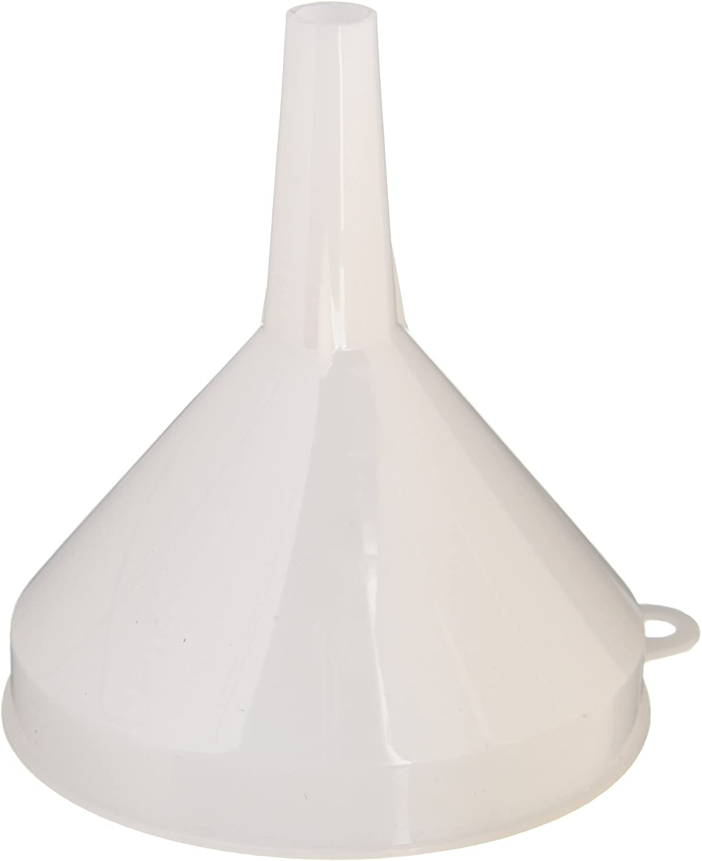
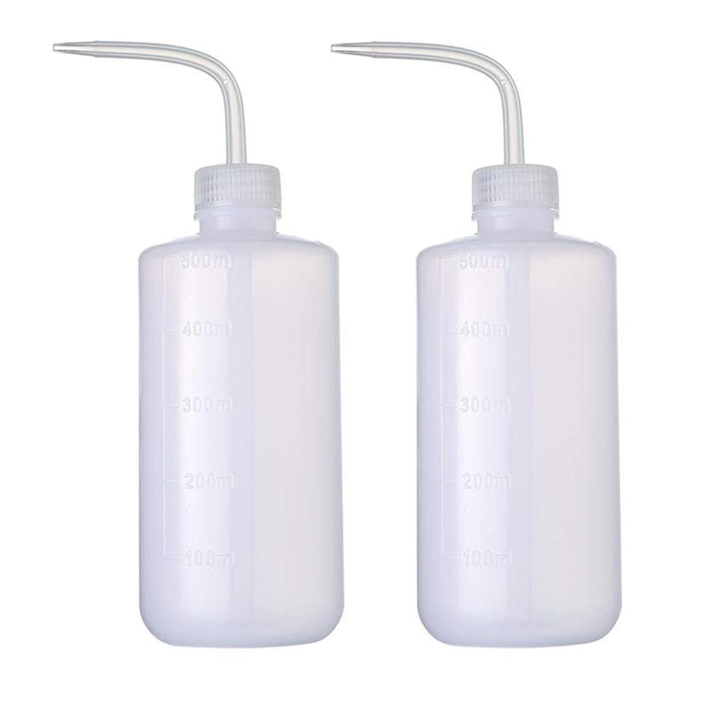
Supplies for filling containers
Laboratory wash bottle
Premeasure pours to avoid overfilling amber bottle
16 oz = $9
Click Here to purchase
Funnel (need stem outer diameter .5” for 4 oz boston bottle)
Click Here to purchase ($4)
Premeasure pours to avoid overfilling

Slide 12
parlement / social formats
Minneapolis Example:
15 attendees
Each opened a bottle from their own cellar
Each had an opportunity to share their experience with their own wine
Duration - 90 minutes
Memorialized by song lyrics by Brian Jackson, and sung to Billy Joel’s Piano Man …

Slide 13
The cellar man (lyrics)

Slide 14
Final tips for the hosts
Consider importing one of your favorite Bordeaux châteaux wines as samples and inviting them to attend the tasting and comment on their wines.
Keep it FUN – light, interesting, and not overly technical.
Help the Zoom tasting run smoothly:
Ask everyone to mute their own microphone unless talking
When the initial email / invitation is sent, offer singles the opportunity to be paired with another single or couple with whom they can talk virtually during the actual tasting portion.
In the initial invitation, ask participants to let you know if they prefer not to talk during the meeting.
Let participants know about the Chat function, in case they are not familiar with Zoom

Slide 15
Sample zoom invitation notes
“Don't forget to pick up your samples from [insert address] on Saturday morning at the time that has been designated especially for you. Please wear a mask and bring a bag to carry your tasting pours.”
“So that everyone will have a chance to be heard, each couple will be given five minutes to discuss their conclusions and the terroir of the wines. We are interested in hearing how you came to your conclusion. After everyone has discussed the wines to the best of their ability I will reveal all!”
“Let me know if you would like to be paired with another person with whom you can talk about the wines as you taste them (by phone or other method). Please let me know, in that case, which of you will act as spokesperson.”
Notes about the tasting theme. Ex. “Remember, the purpose of the tasting is to decide the vintage and which of the wines is not like the others. Four wines are from the same commune. The odd wine out is from a different commune. You are invited to identify the communes if you’d like.”

Slide 16
Discussion points for the reveal
Focus on structure over aromas and flavors
Structure is the most reliable method for identifying grape varieties, commune, vintage, etc.
Once an identification is made based on structural factors … then aromas and flavors can be helpful in confirming that identification
Wine color is especially helpful in identifying maturity level

Slide 17
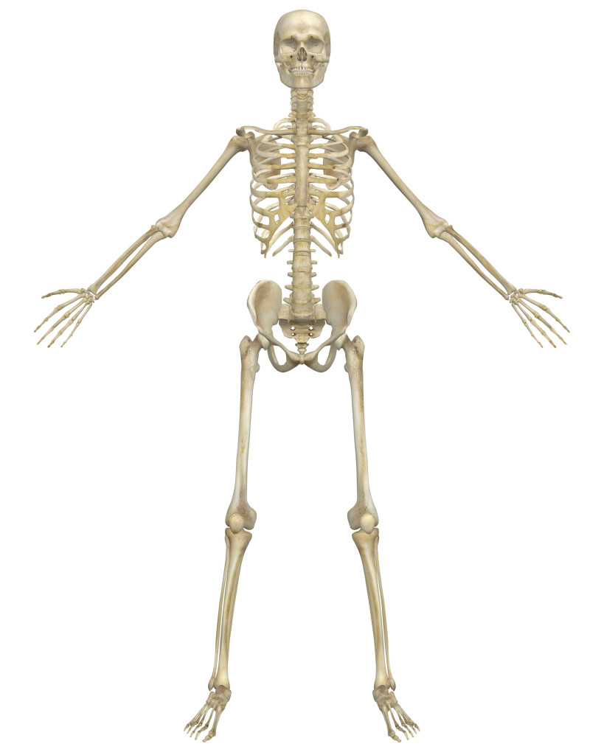
what is structure
Wine’s structure is comprised of:
Tannins
Acids
Alcohol
Tannin and acid levels will typically be consistent for any particular grape variety
Grape varieties can also possess distinct tannin characteristics, e.g. fine-grained, rustic
Tannins will indicate maturity, e.g., grippy tannins can indicate youthfulness
© Kelleen Hubbs

Slide 18
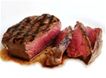
What is not structure
Wine’s flesh comes from the perception of:
Fruit (flavors and aromas)
Suppleness / Mellowness
Body (alcohol, lees aging, etc.)
© Kelleen Hubbs

Slide 19
Bordeaux red varieties
The following slides contain descriptions of the main red wine varieties (excluding Carménère, which is rarely used)
The brief synopsis of how each variety behaves in the vineyard explains the structural characteristics (e.g. thick skins create higher level tannins), and can also provide clues for vintage analysis
Tannin and acid characteristics should be the primary focus
Common aroma / flavor characteristics may confirm conclusions based on structure as to the grape varieties
© Kelleen Hubbs

Slide 20
Cabernet sauvignon
Small blue/black berries
Thick skin
Large seeds
Loose bunches
Tough hardwood stocks
Susceptible to oidium, but generally resistant to rot, pests, diseases and cold
Buds late
Ripens late
© Kelleen Hubbs

Slide 21
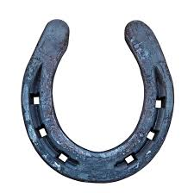
Cabernet Sauvignon
Palate:
Medium to high tannins
Tannins
Grainy, but fine and tightly-knit (“sleek”)
Felt on the gums and sides of mouth
Linear “like an arrow” or “horseshoe” moving toward the back palate
Woody, stalky, green if not fully ripe
Medium to high acidity
Medium to high alcohol
© Kelleen Hubbs

Slide 22
Cabernet sauvignon
Cigar box
Blackcurrant or Cassis
Eucalyptus
© Kelleen Hubbs

Slide 23
merlot
Large, dark berries
Thin skins (low tannin, high sugar)
Early budding, flowering
Early ripening
Vine tolerates cooler, wetter soils
Also does well in dry, well-drained soil
© Kelleen Hubbs

Slide 24
merlot
Palate:
Medium tannin (typically lower than Cabernet Sauvignon high quality versions can have high tannins)
Tannins
Firm, fine-grained
Well-integrated with the fruit (less pronounced than in Cab. Sauv.)
Felt on the gums on all sides of the mouth (“square” or lingering)
Can feel “sticky” or “clayey”
Occasionally stalky
Low to Medium acidity (lower than Cabernet Sauvignon)
Medium to high alcohol
Ripe fruit fills the mid-palate (vs. horseshoe sensation of Cab. Sauv.)
© Kelleen Hubbs

Slide 25
merlot
Plum
Coffee
Chocolate
© Kelleen Hubbs

Slide 26
Cabernet franc
Large berries
Fairly loose bunches
Generally hardy
Buds early
Ripens early
Tolerates cool climate and cool, wet soils
© Kelleen Hubbs

Slide 27
Cabernet Franc
Palate:
Medium tannins
Tannins
Grainy
Felt on the gums
Stalky
Medium to high acidity
Medium to high alcohol
© Kelleen Hubbs

Slide 28
Cabernet franc
Raspberry
Violet
Currant Leaf
and / or
Herbaceous
*Also, sometimes tea and warm spice at the best right-bank châteaux (Nick Jackson, MW)
© Kelleen Hubbs

Slide 29
Malbec
Called “pressac” on right bank
Small, dark berries
Thin skin
Adds color and structure to blends
Prone to coulure, downey mildew, rot
Relatively high yields
Limestone gives it dark color and firm structure
© Kelleen Hubbs

Slide 30
Malbec
Appearance:
Dark, inky color
Palate:
High tannins
Tannins
Grainy, rustic, “blocky” (unlike “horseshoe” or “arrow” of Cab. Sauv.)
Dense, powerful
Felt on the gums and hinge of the jaw
© Kelleen Hubbs

Slide 31
malbec
Tobacco
Coffee
Blackberry
© Kelleen Hubbs

Slide 32
Petit verdot
Late ripening (later than Cabernet Sauvignon)
Small, dark berries
Adds color and structure to blends
Prone to disease
© Kelleen Hubbs

Slide 33
PETIT VERDOT
Appearance:
Dark, inky color
Palate:
Medium to high alcohol
Full body
Medium plus to high acid
High tannins
© Kelleen Hubbs

Slide 34
Petit verdot
Dried herbs
Spice
Violet
© Kelleen Hubbs

Slide 35
Major left bank Communes
St-Estephe
Driest wines of the major AOCs
Tannins often not well-integrated
Powerful cassis flavor
Good in hot vintages
Often a “salty” note
Pauillac
Complex, deep aromas
Well-integrated tannins
St-Julien
Intense gravel and cassis aromas
Cabernet Sauvignon is linear, precise, and fresh
Margaux
Needs a warm vintage to shine
More Merlot than the other major three left bank communes, often shared 50/50 with Cabernet Sauvignon
* From Beyond Flavour, Nick Jackson, MW

Slide 36
Major right bank Communes
St-Emilion
Fresh acidity
Medium, firm tannins
Bright red fruits
Rich mid-palate
Often chalky finish
Pomerol
Velvety, generous fruit
Tannins are well-integrated with fruit
Cabernet Franc can have herbal, spicy tea characteristics
Plummy Merlot
Merlot creates classic wines in cooler vintages
Merlot can create “excessive” wines in warm vintages
* From Beyond Flavour, Nick Jackson, MW

Slide 37
bordeaux white varieties

Slide 38
Sauvignon blanc
Medium-size berries
Tight bunches
Late budding
Early ripening
High acid
Susceptible to botrytis
Vulnerable to oidium and black rot (black rot especially on fertile soils)
Ripens easily
High yields
Needs long growing season for sweet styles
© Kelleen Hubbs

Slide 39
Sauvignon Blanc
Appearance:
Pale yellow
Palate:
High acidity
Acidity
Prickly or jagged
Felt around edges of mouth, also roof and gums
Not integrated with the fruit
Low to medium body
Medium alcohol
© Kelleen Hubbs

Slide 40
Sauvignon blanc
Gooseberry
Grass
Asparagus
Peas
Mineral / wet stone
© Kelleen Hubbs

Slide 41
SÉmillon
Thin skin
Fairly easy to grow
Susceptible to botrytis
© Kelleen Hubbs

Slide 42
SÉmillon
Appearance:
Golden color
Palate:
Neutral, flat-tasting in youth / Develops rich, honeyed complexity in bottle
Medium to full body
Waxy texture
Acidity varies – in Bordeaux, acidity is usually high:
Bordeaux acidity = zesty, tangy, “electric”
Low to medium alcohol
© Kelleen Hubbs

Slide 43
SÉmillon
Toast
Honey
Lanolin
© Kelleen Hubbs

Slide 44
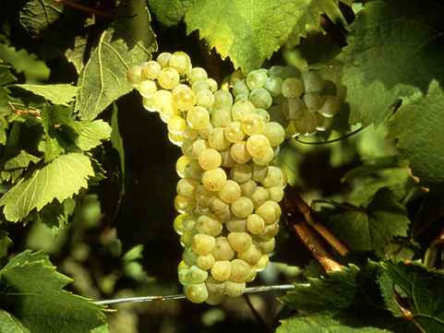
muscadelle
Somewhat susceptible to botrytis
© Kelleen Hubbs

Slide 45
MUSCADELLE
Nose:
Intense aromas
In Bordeaux, flowery
Palate:
Low acidity
Round
© Kelleen Hubbs

Slide 46
muscadelle
Floral
Musky
Grapey

Slide 47
Vintage effect
The following slides can be used to help analyze or invite a discussion of a particular vintage’s effect on the wines

Slide 48
Vintage - Clues
Red wines:
Generous fruit and ripe tannins = warmer than usual vintage
Fruit finish = ripe fruit, good vintage
Acid finish = lesser vintage
White wines:
Tart, linear = could be from a difficult vintage
Need preservation of acidity for quality wine
© Kelleen Hubbs

Slide 49
Vintage – weather effect
Spring frosts can also reduce the number of branches that will develop on each vine, and can cause millerandage and coulure, affecting yield
Earlier flowering varieties, like Merlot and Cabernet Franc, are more affected than late-flowering varieties, like Cabernet Sauvignon
These conditions can affect the supply of inexpensive, ready-to-drink red Bordeaux which has a high proportion of Merlot
Cold, rainy springs can also cause millerandage or coulure, affecting yield
*See the end of this PPT for an explanation on millerandange and coulure
© Kelleen Hubbs

Slide 50
Vintage – weather effect
Very hot, dry summers
Earlier flowering varieties, like Merlot and Cabernet Franc, are more affected than late-flowering varieties, like Cabernet Sauvignon
This can affect the supply of inexpensive, ready-to-drink red Bordeaux which has a high proportion of Merlot
Excessive summer rain – rain is necessary for vine and grape growth, but in excess can cause rot
Also, while it does not affect vintage, it can erode important topsoil on steep slopes
© Kelleen Hubbs

Slide 51
Vintage – ideal weather
Spring:
10˚C / 50˚F needed for budburst
15˚C / 59˚F and plenty of sunlight and little/no rain are good for flowering and fruit set
Summer
Some rain, but not excessive
Sunlight, but not excessive
Autumn
Right Bank - not too hot (to avoid overripeness in Merlot, loss of structure and acidity)
Left Bank – long and warm (Cab Sauv reaches optimal ripeness – fruit balances with tannins)
No storms or heavy rains to dilute the grapes
rains coming before harvest are a greater hazard for the right bank, due to heavier soils and greater susceptibility to rot (Merlot has thin skins)
© Kelleen Hubbs

Slide 52
Vintage spring weather problems
Millerandage
“Shot berries” / “hens and chicks”
Uneven ripening of berries (difference in size and maturity)
Caused by cold, rainy, bad weather during flowering
Affects yield and can affect quality
No treatment
© Kelleen Hubbs

Slide 53
Vintage - spring weather problems
Coulure
“Shatter”
Failure of berries to develop after flowering
Caused by cold (e.g. frost), cloudy, rainy weather or very high out-of-season temperatures during flowering
Affects yield and can affect quality
No treatment
© Kelleen Hubbs

